Slide 1
VESP Overview
Len Drago
Ombudsman / Tribal Liaison

Slide 2
V
oluntary
E
nvironmental
S
tewardship
P
rogram

Slide 3
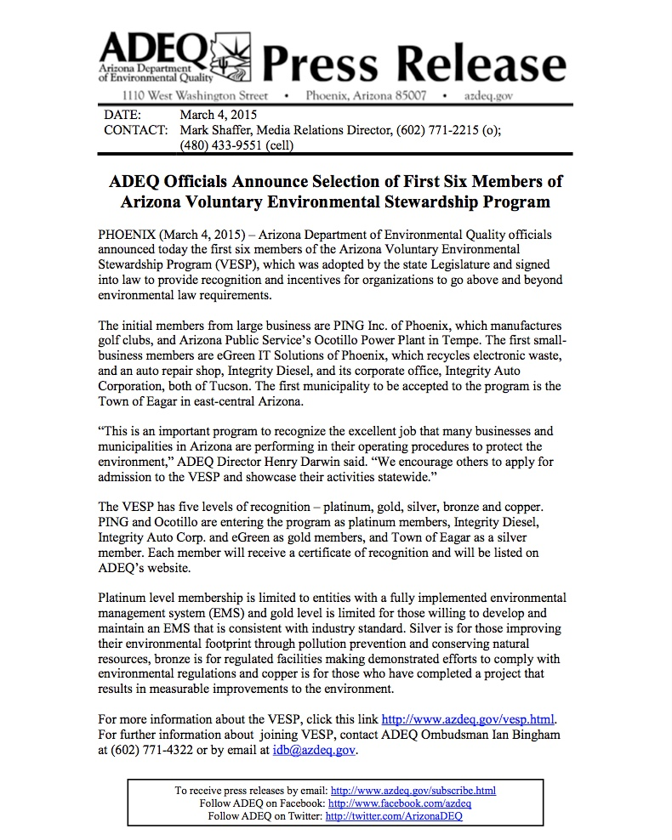
VESP Timeline
March 4, 2015
Press Release
announcing official
Program launch
Voluntary Environmental Stewardship Program (VESP) Development Summary

Slide 4
Copper and Bronze Requirements
Copper: One time recognition
For partnerships, collaborations or regulated facilities that have completed a project that resulted in measurable improvements to the environment
No application required
Bronze: Sustained compliance with environmental laws for a three year history
For regulated facilities making a demonstrated effort to comply with environmental regulations
No application required

Slide 5
Advancement Requirements
Silver:
For organizations improving their environmental footprint by preventing pollution and conserving natural resources and;
Meet minimum requirements (see next page)
Gold
For organizations willing to develop and maintain an Environmental Management System (EMS) that is consistent with the ISO 14001 standard and;
Meet minimum requirements (see next page)
Platinum
For organizations with a fully implemented Environmental Management System (EMS) and;
Meet minimum requirements (see next page)
Demotions and Revocations possible based on compliance performance

Slide 6
Minimum Requirements - Silver, Gold, and Platinum
Sustained compliance with environmental laws for a three year history
Electronic application required
Going above and beyond the requirements of environmental laws
Pollution prevention and improving its environmental performance
Annual Report documenting progress on commitment(s)
Membership good for three-years

Slide 7
Potential Benefits and Incentives
Inspection Pre-Notifications
Recognition
Opportunity to Negotiate Permit Flexibility

Slide 8
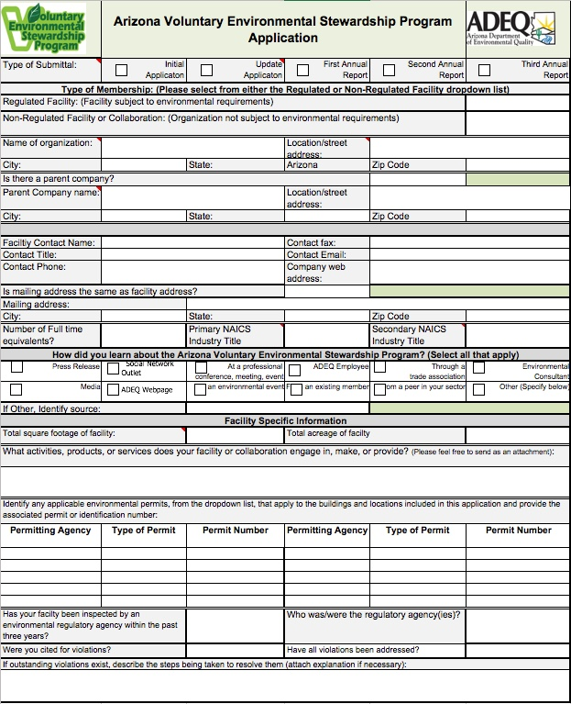
VESP is a Voluntary Program
VESP
IS
NOT
A
LICENSE

Slide 9
Contact Information
Len Drago
Ombudsman & Tribal Liaison
Arizona Department of Environmental Quality
1110 West Washington Street
Phoenix, AZ. 85007
602-771-2288
drago.len@azdeq.gov
www.azdeq.gov
VESP Webpage
www.azdeq.gov/other/VESP

